Slide 1
2.25.2021
Introduction to Xamarin.Forms
Kevin Ford
kevinf@magenic.com
617 359-5192

Slide 2
https://github.com/Magenic/IntroToXamarinForms

Slide 3
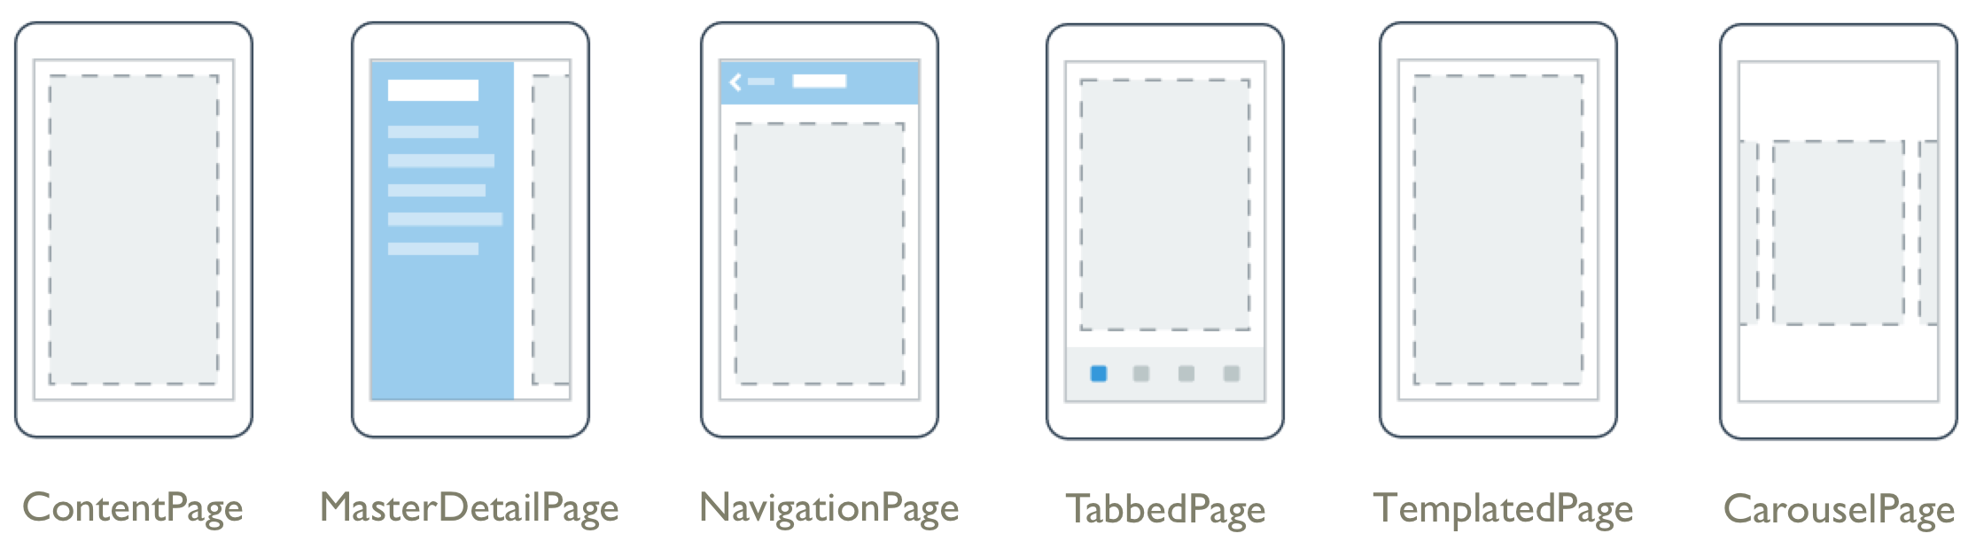
UI Concepts
Page
View
Layout
Cell
FlyoutPage

Slide 4
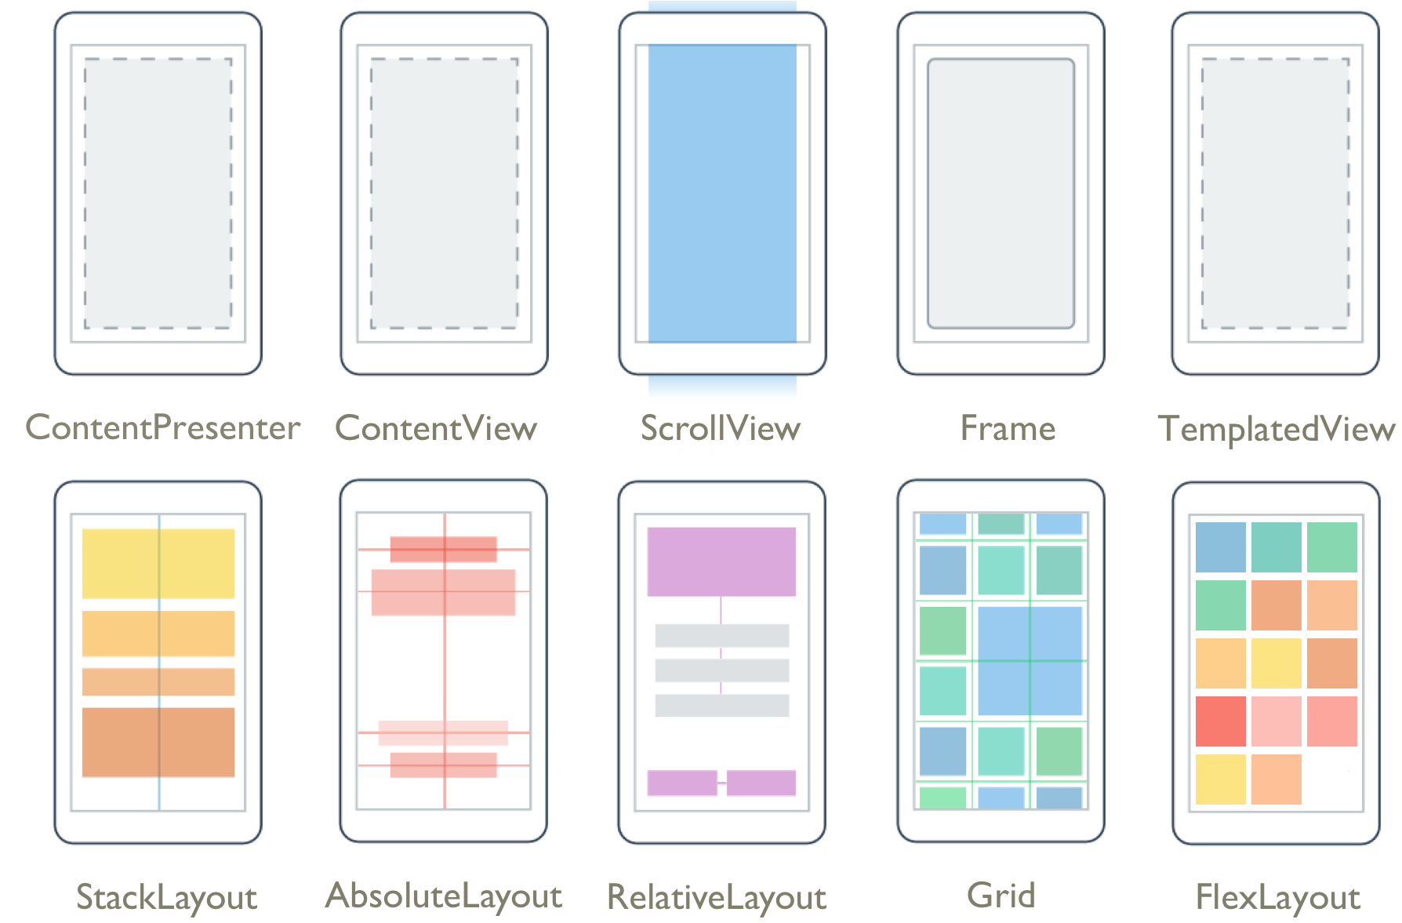
Xamarin Forms Layouts

Slide 5
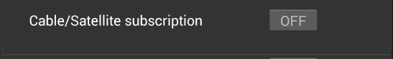
StackLayout
<StackLayout Orientation="Vertical" Spacing="20" Padding="0, 0, 0, 0">
<StackLayout Style="{StaticResource
IndividualEntryRegionStyle}">
<controls:ExtendedLabel Text="{Binding
OptionText}”
HorizontalOptions="StartAndExpand"
Style="{StaticResource LabelStyle}" />
<Switch IsToggled="{Binding IsOptionSelected,
Mode=TwoWay}" HorizontalOptions=”Fill" />
</StackLayout>
<BoxView HorizontalOptions="FillAndExpand"
Style="{StaticResource LineStyle}"></BoxView>
</StackLayout>
Start and Expand
Fill
Stack Layout
Padding = 20
Padding = 20
BoxView
Spacing = 20

Slide 6

Sizing Views
Sizing is a collaboration
View want’s width to be same as parent and height to be same a width
Layout queries view for requested size
Layout returns the size allocated
Layout returns space it is allocating: for example: 360 x 360
Units determined by platform
iOS: Points
UWP: Effective Pixels
Android: Density Independent Pixels (dp or dip)

Slide 7
View Layout Preferences
Four preference Types
HeightRequest
WidthRequest
VerticalOptions
HorizontalOptions
VerticalOptions/HorizontalOptions default to fill

Slide 8
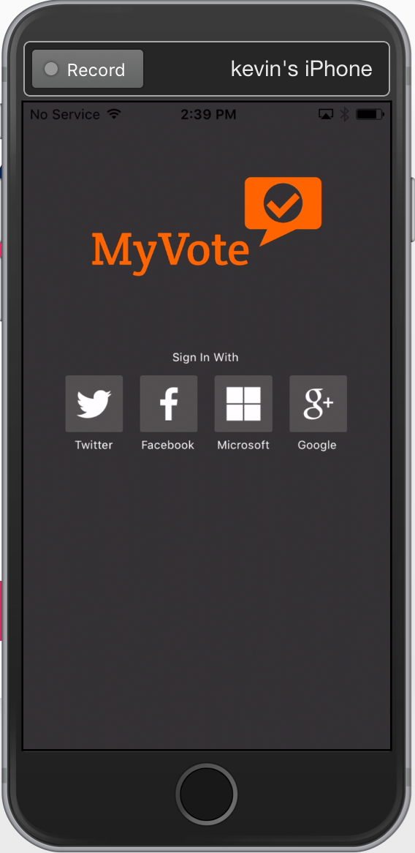
Vertical/Horizontal Options
View Layout Options
Start
StartAndExpand
End
EndAndExpand
Center
CenterAndExpand
Fill
FillAndExpand
“AndExpand” options only used on StackLayouts

Slide 9
StackLayout and ‘AndExpand’
‘AndExpand’ Options take all available space
If multiple ‘AndExpand’ views, remaining space shared equally
Expansion only in direction of orientation
View only takes up unexpanded size
LeftPadding = 20
Start and Expand
Fill

Slide 10
LayoutOptions Need to Know
Non ‘AndExpand’ options ignored when with StackLayout orientation - Fill
Start
End
Center
Fill
‘AndExpand’ ignored when opposite StackLayout orientation
StartAndExpand = Start
EndAndExpand = End
CenterAndExpand = Center
FillAndExpand = Fill

Slide 11
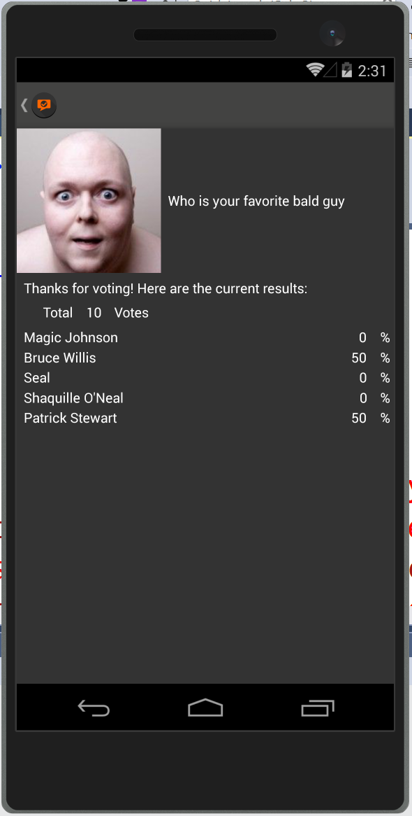
Grid Layout
<Grid.RowDefinitions>
<RowDefinition Height="Auto" />
<RowDefinition Height="Auto" />
<RowDefinition Height="Auto" />
<RowDefinition Height="Auto" />
<RowDefinition Height="*" />
</Grid.RowDefinitions>
</Grid.ColumnDefinitions> <ColumnDefinition Width="Auto" />
<ColumnDefinition Width="*" />
</Grid.ColumnDefinitions>
<Image Grid.Column="0” Grid.Row="0"
VerticalOptions="LayoutOptions.Start"
WidthRequest="150" HeightRequest="150"
Aspect="AspectFill”
Source="{Binding PollResults.PollImageLink}" />
Row = 0
ColumnSpan=2
Row = 1
Row = 2
Row = 3
Row = 4
Column = 0
Column = 1

Slide 12
Relative Layout
<RelativeLayout HorizontalOptions="FillAndExpand” VerticalOptions="FillAndExpand">
<Image x:Name="curImage" Aspect="AspectFill"
VerticalOptions="FillAndExpand" Source="{Binding ImageLink}"
RelativeLayout.XConstraint="{ConstraintExpression Type=RelativeToParent, Property=Width, Factor=0, Constant=0}"
RelativeLayout.YConstraint= "{ConstraintExpression Type=RelativeToParent, Property=Height, Factor=0, Constant=0}"
RelativeLayout.WidthConstraint= "{ConstraintExpression Type=RelativeToParent, Property=Width, Factor=1, Constant=0}"
RelativeLayout.HeightConstraint= "{ConstraintExpression Type=RelativeToParent, Property=Width, Factor=1, Constant=0}">
</Image>
<controls:ExtendedLabel Text="{Binding Question}" HeightRequest="75" LineBreakMode="WordWrap" TextColor="White" Font="Bold“
BackgroundColor="#98434342"
RelativeLayout.WidthConstraint= "{ConstraintExpression Type=RelativeToParent, Property=Width, Factor=1, Constant=0}"
RelativeLayout.XConstraint= "{ConstraintExpression Type=RelativeToParent, Property=Width, Factor=0, Constant=0}"
RelativeLayout.YConstraint= "{ConstraintExpression Type=RelativeToView, ElementName=curImage, Property=Height, Factor=1, Constant=-75}" />
</RelativeLayout>
X = Parent width * 0 = 0
Y = Image Height * 1 - 75 = (Image Height – 75)
Y = Parent height * 0 = 0
Height = Parent height * 1 = Parent height
Height = 75
Width = Parent width * 1 = Parent width
Width = Parent width * 1 = Parent width

Slide 13
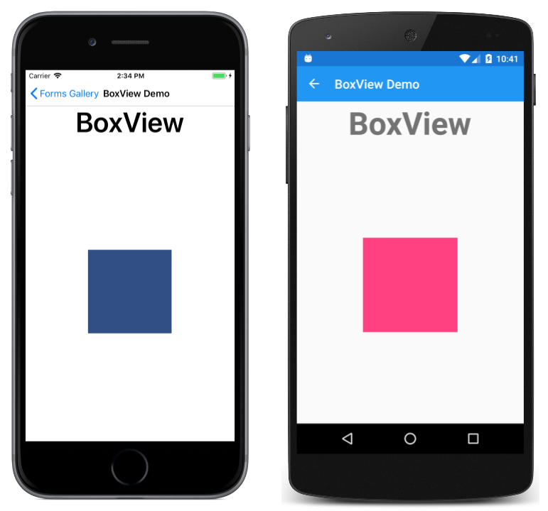
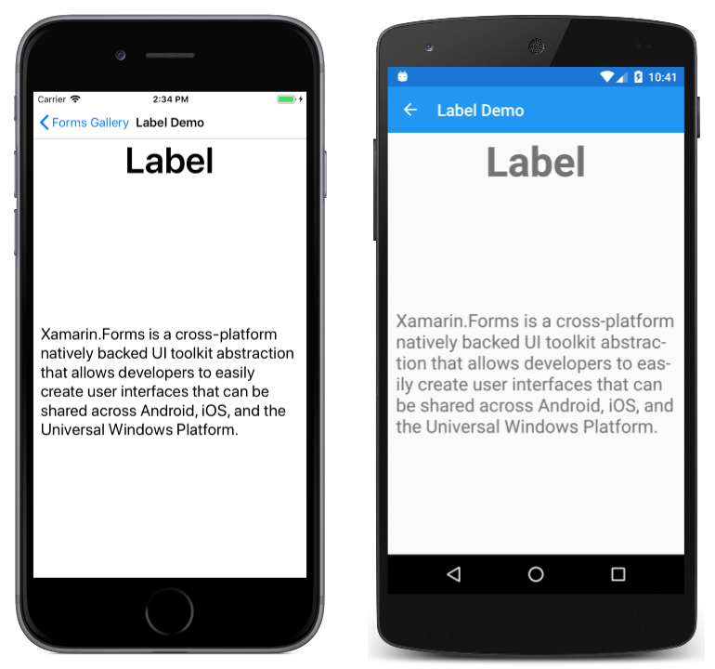
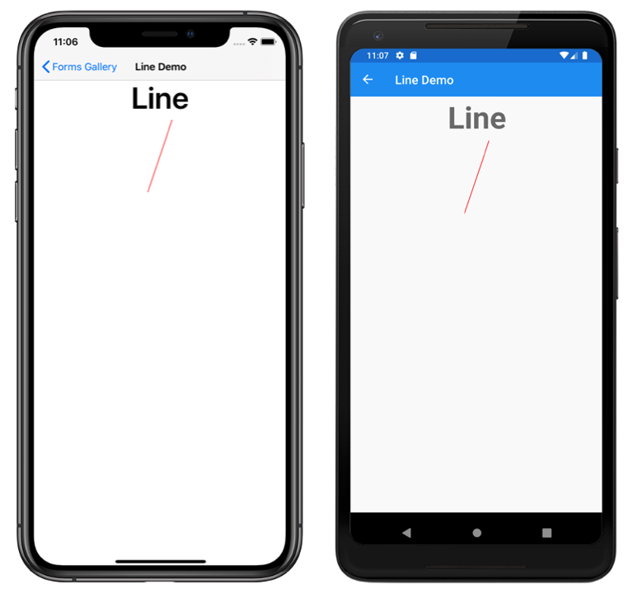
Views

Slide 14

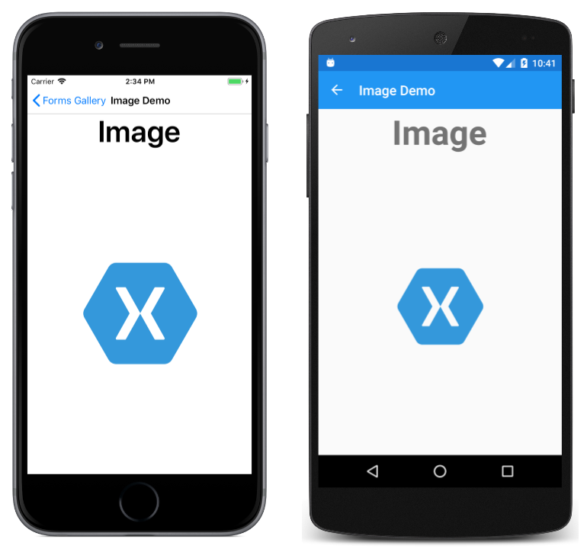
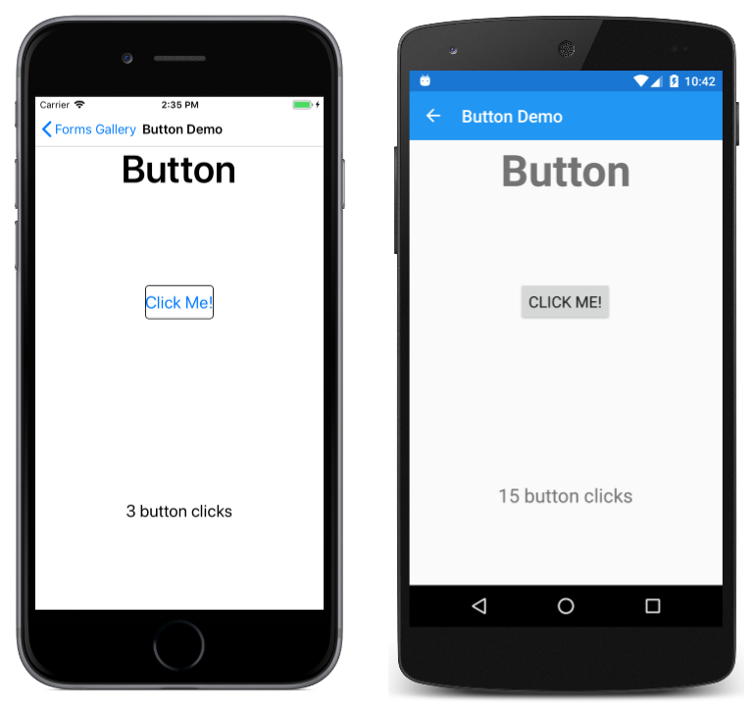
Views

Slide 15
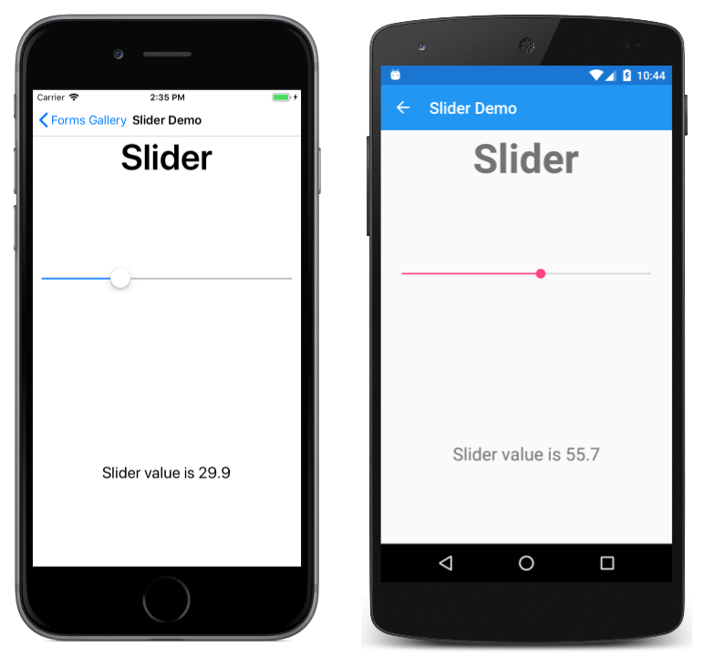
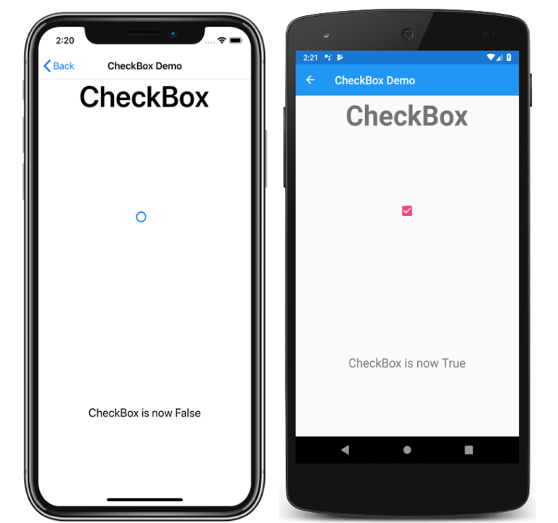

Views

Slide 16

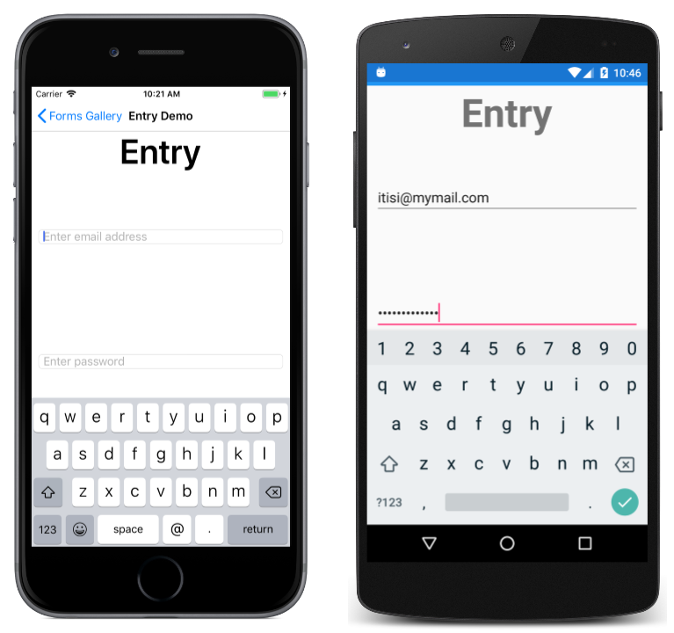
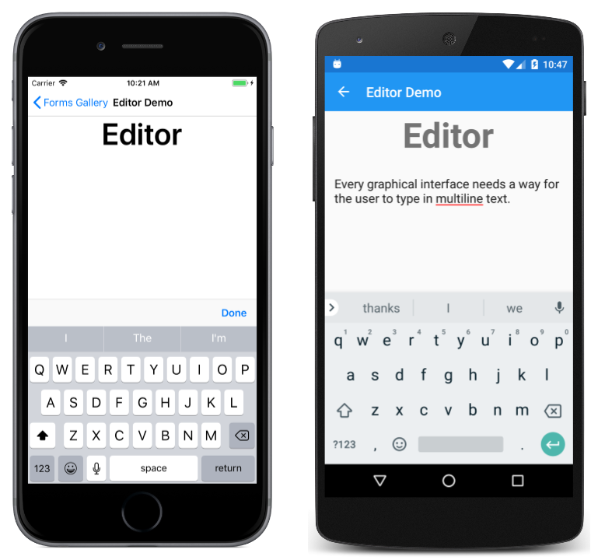
Views

Slide 17
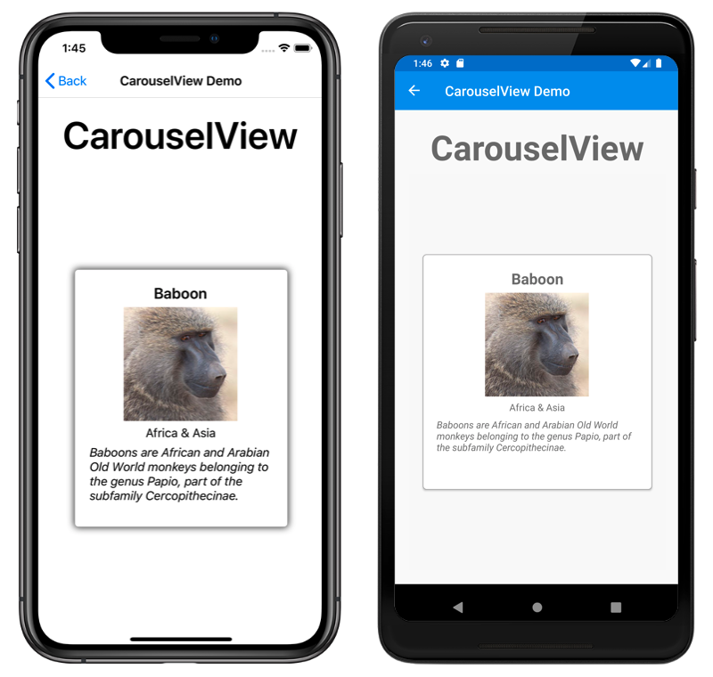
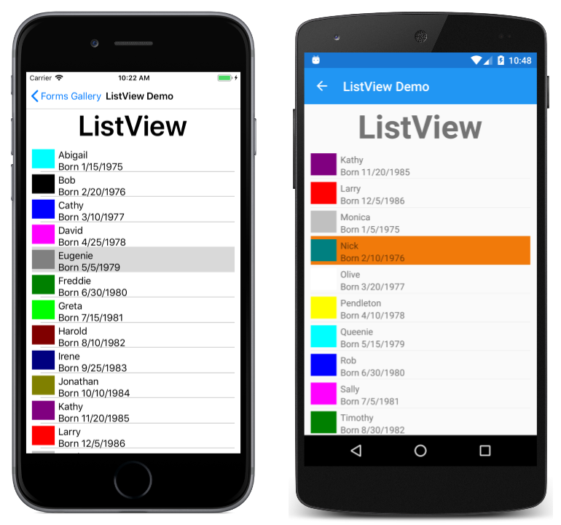
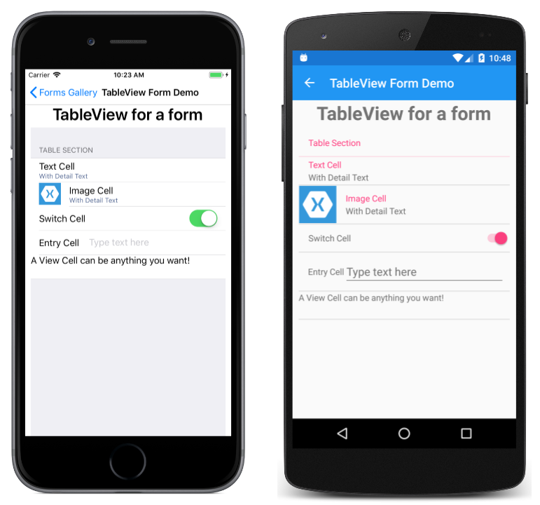
Views

Slide 18
And the list keeps coming
https://docs.microsoft.com/en-us/xamarin/xamarin-forms/user-interface/controls/views

Slide 19
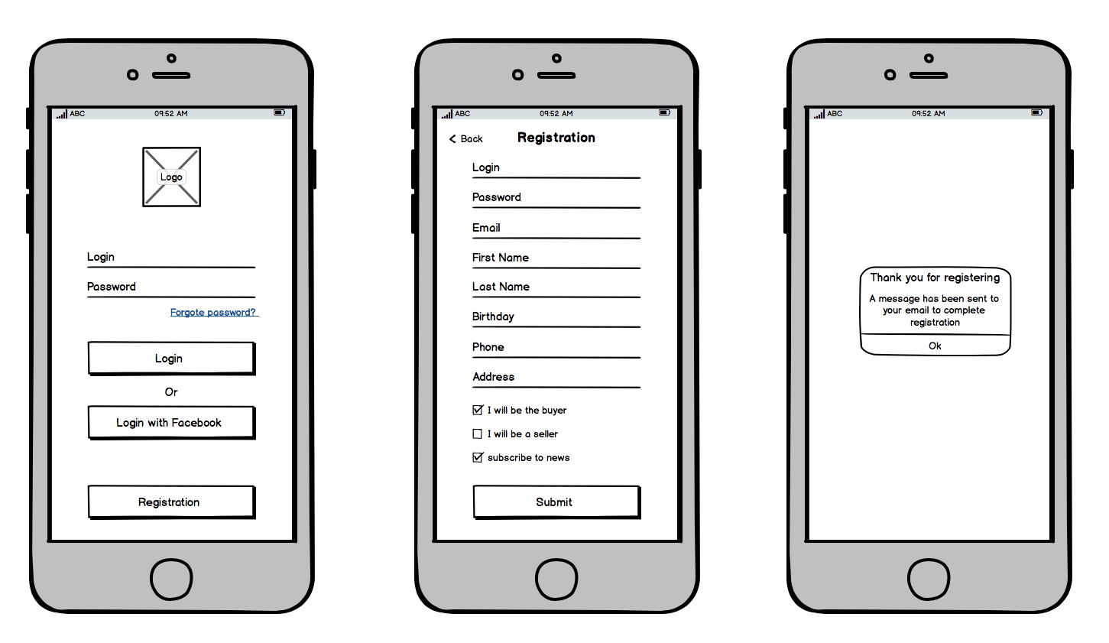

Slide 20
Homework
Play with the views and layouts

Slide 21
Q & A
Next week – Data Binding

